Slide 1
May 31st Novo Nordisc Capstone Update
Josh Smith, Jay Rutherford, Chris Nyambura
Mentor: Jon Rue

Slide 2
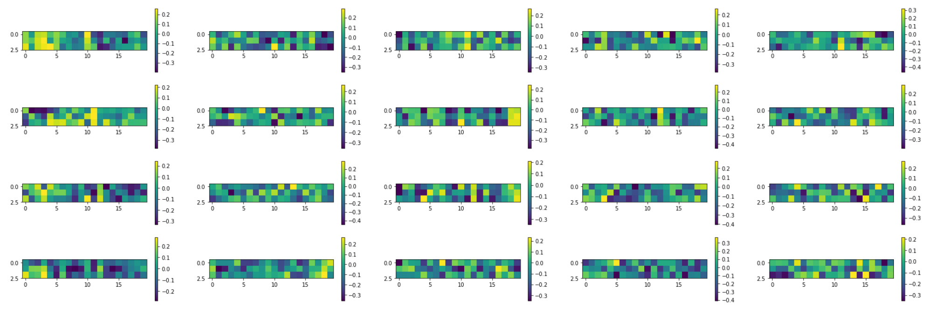
FILTER VIZUALIZATION Amino Acids ordered by Hydrophobicity Filter width = 3, Accuracy = 62%

Slide 3
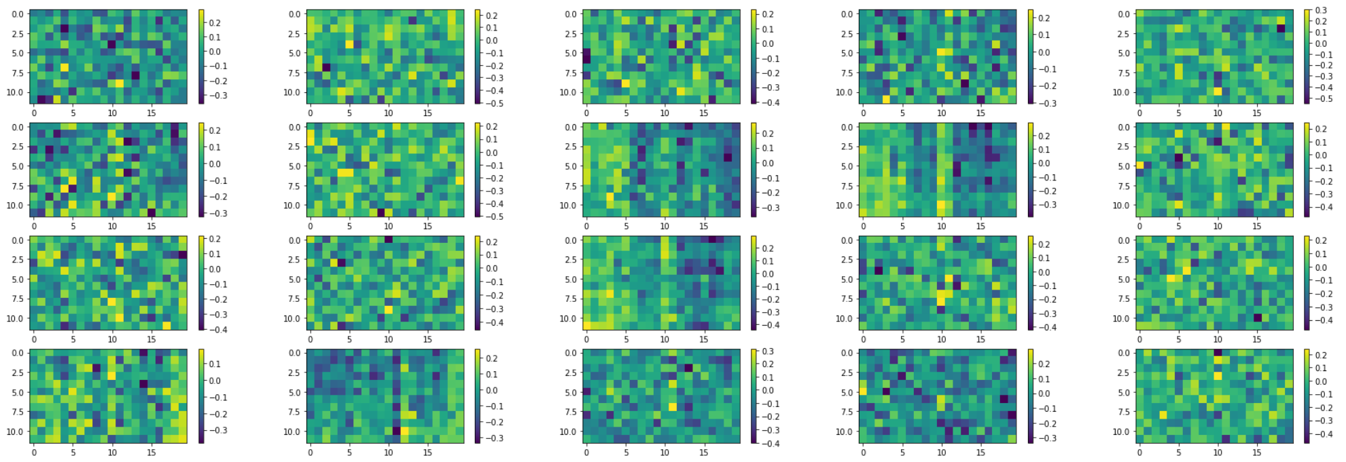
FILTER VIZUALIZATION Amino Acids ordered by Hydrophobicity Filter width = 12, Accuracy = 65%

Slide 4
ENSEMBLE MODEL
Combined 1D Conv Net with FCN using calculated features
Did not improve accuracy

Slide 5
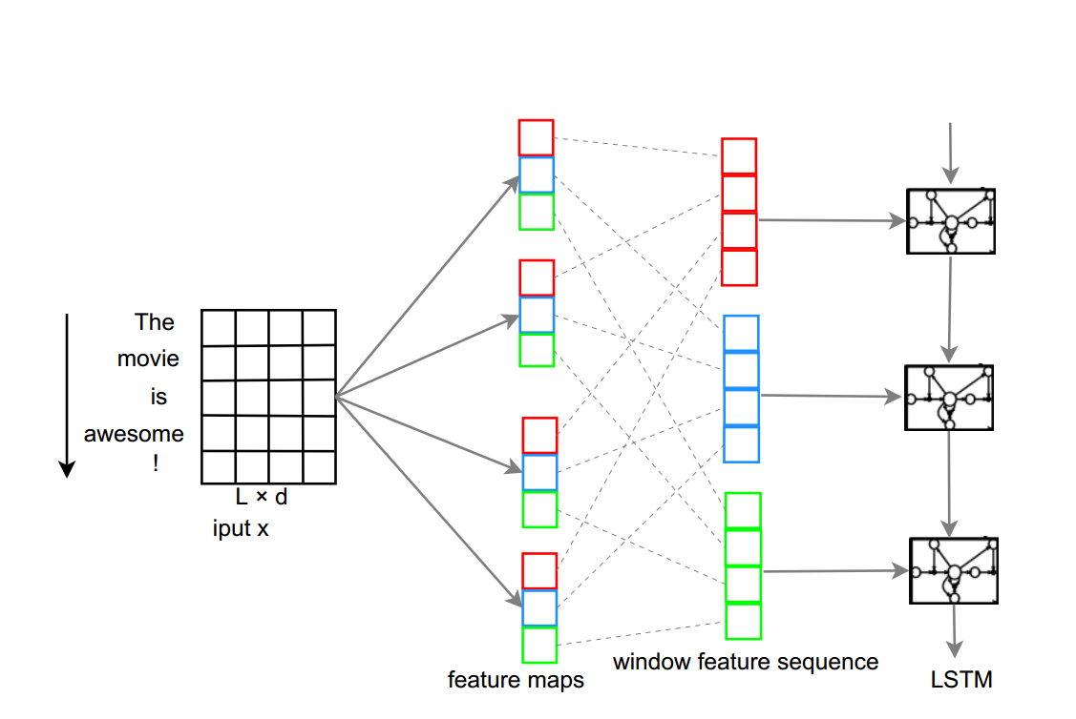
EMBEDDING
Zhou et. al. A C-LSTM Neural Network for Text Classification

Slide 6
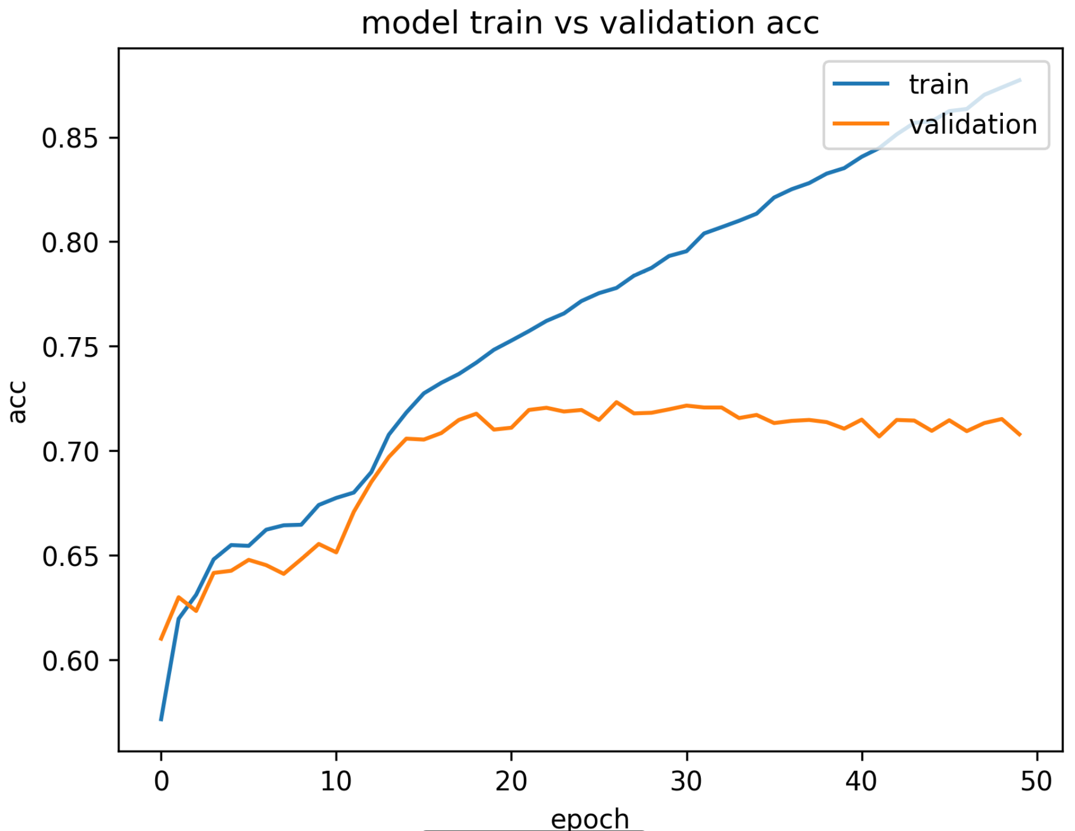
EMBEDDING
Achieved 72% Accuracy
(some optimization and 5 fold cross validation)

Slide 7
FUTURE WORK
(What to focus on)
Continue Optimization
More extensive grid search (Google Cloud)
Filter Interpretation and other ways to interpret models
Build Package to encode and generate models
Revisit Regression

